Slide 1
Yeienhwi’s onywawenda’ «I’m learning our language»
O’niänih 2 (Week 2)
Skat Level (Level 1)
Language sector, CDFM huron-wendat

Slide 2
O’niänih 2 Onhwa’ entate’ ….
Basic imperatives;
The Wendat language: the base form;
Introduction on vocabulary about nature;
Game;
Challenge!

Slide 3
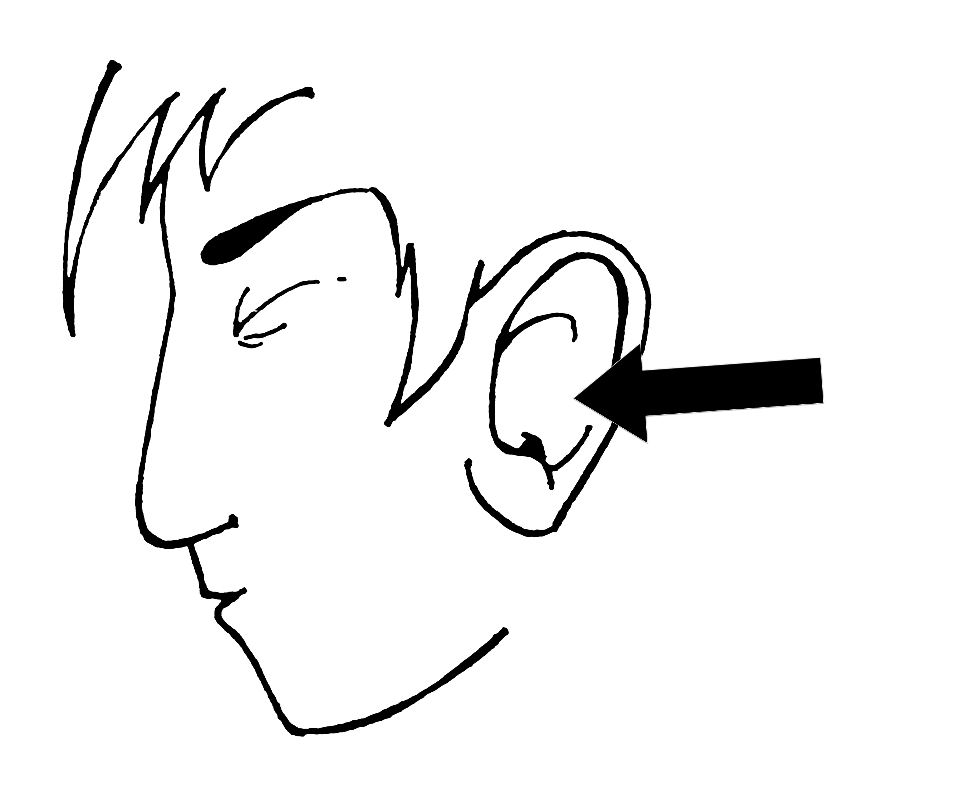
Base imperatives
Satienh ! → Sit down!
16. Satriho’tat ! → Listen! Pay attention!
17. Sakwendahton’t ! → Shut up!
Images de Louis-Karl Picard-Sioui

Slide 4
Base imperatives
15. Satienh ! [SA-tienh]
16. Satriho’tat ! [sa-tri-HO’-tat]
17. Sakwendahton’t ! [sa-kwen-DAH-ton’t]

Slide 5
Base imperatives
18. Tsatienh ! → Sit down! (plural)
19. Satriho’tat ! → Listen! Pay attention! (plural)
20. Tsakwendahton’t ! → Shut up! (plural)
Images de Louis-Karl Picard-Sioui

Slide 6
Base imperatives
18. Tsatienh ! [TSA – tienh]
19. Tsatriho’tat ! [tsa – tri – HO’ – tat]
20. Tsakwendahton’t ! [tsa – kwen – DAH – ton’t]

Slide 7
The Wendat language: the base form;
The Wendat language is composed of:
Verbs
Nouns
Particles

Slide 8
The wendat language: the noun structure
NOUN STRUCTURE
Yänonhchia’
Ya- + -nonhchi- + -a’
Pronominal prefix | Nominal root | Nominal ending

Slide 9
The wendat language: the verb structure
STRUCTURE DU VERBE
Yehiatonhk
Ye- + -hiaton- + -hk
Pronominal prefix | Verb root | Aspectual ending

Slide 10
Vocabulary : Nature
yaronhia’ → sky enta’ → day
[ya – RON – hia’] [EN – ta’]
ya – ronhi – a’ ent-a’

Slide 11
Vocabulary : Nature
yashe’ta’ → squash, bottle önenha’ → corn
[ya – SHE’ – ta’] [ö – NEN – ha’]
ya –she’t– a’ ö –nenh-a’

Slide 12
Vocabulary : Nature
otsi’tsa’ → flower, beer yahndawa’ → river
[o – TSI’– tsa’] [yah – NDA – wa’]
o –tsi’ts– a’ ya –hndaw-a’

Slide 13
Vocabulary : Nature
oyare’sa’ → bean ontara’ → lake, sea
[o – ya – RÈ’– sa’] [on – TA – ra’]
o –yare’s– a’ i -ontar- a’

Slide 14
Vocabulary : Nature
yarënda’ → rock, stone yarha’ → forest
[ya – RÈ– nda’] [YAR – ha’]
ya –rënd– a’ ya -rh- a’

Slide 15
Vocabulary : Nature
ahsonta’ → night yaronta’ → tree
[ah – SON– ta’] [ya– RON- ta’]
w -ahsont- a’ ya -ront- a’

Slide 16
Vocabulary : Nature
yänrahta’ → leaf
[ya – NRAH– ta’]
ya -nraht- a’

Slide 17
Homework
1) Every vocabulary word seen today have been deconstructed!
-pronominal prefix
-nominal root
-endings
You must reconstruct them!

Slide 18
Homework
2) Identify the nominal roots in the joined document.
Önenh chia’ eskwayen’ !

